Slide 1
Team Khristah Purni
GIS Based flood Detection

Slide 2
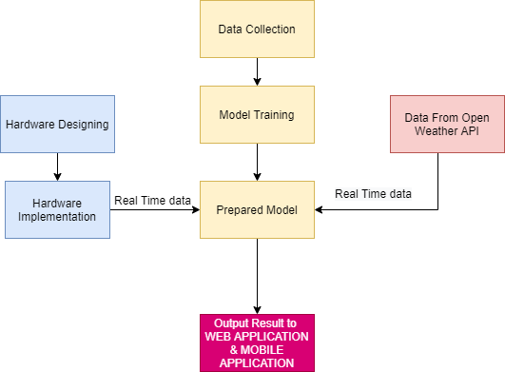

Slide 3
Data Source
The data are being collected from reliable sources including:
Gsdma.org
Bhuvan.nrsc.gov.in
IndiaWRIS
power.larc.nasa.gov/data-access-viewer
Note: All the data is related to banaskantha District only

Slide 4
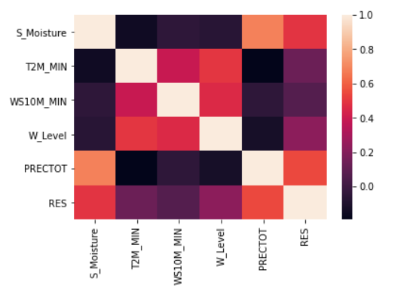
Labels For Classification
Soil Moisture
Temperature
Wind Speed
Water Level
Rainfall

Slide 5
Categories For Classification
0 - No Danger/ No chance
1 - Slight chance of flood
2 - Moderate chance of flood (Take measures)
3 - High chance of flood (Take measures)

Slide 6
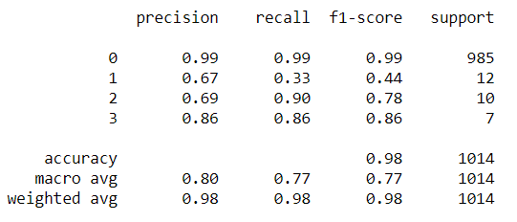
Findings

Slide 7
Sensor Implementation
The sensor are to be implemented for the real time value feed for the following:
Water Level
Soil Moisture
Rainfall

Slide 8
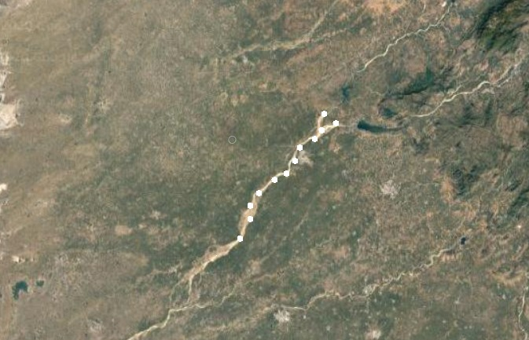
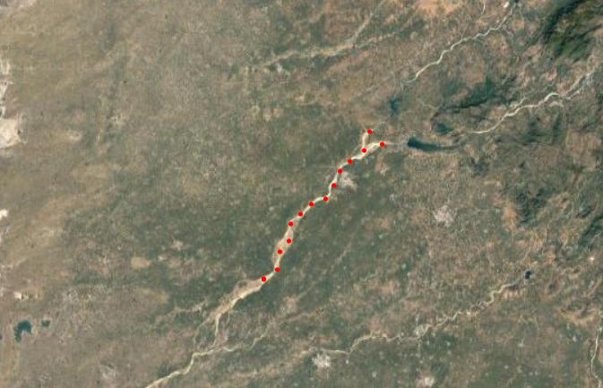
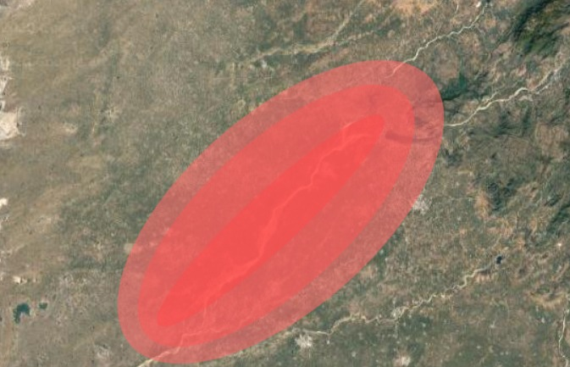
Sensor Implementation

